Slide 1
Timelines are for you!
Midwest African American Genealogy Institute (MAAGI)
Dr. Shelley Viola Murphy
~
RT9421 Wed, 28 Feb 2018, 1:30p
GS9421 Fri, 2 Mar 2018, 1:30p

Slide 2
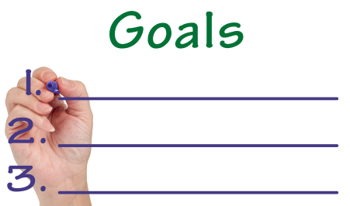
Our Goal!
Brief overview of getting started with genealogy research.
To provide support and validation to those that use timelines
To motivate those who don't use timeline to use them
Brief overview of the BENEFITS OF USING A TIMELINE
Stompin' thru a timeline one droplet at a time.
SO WHAT! Looking at Howard hart-Death certificate
And more!

Slide 3
Basic tips…
No one said it will be easy!

Slide 4
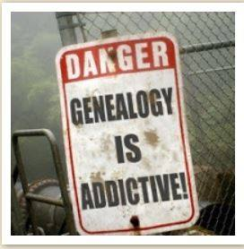
Learn the system of Genealogy Research
Know the basics of genealogical research
Learn the laws that were in place
Learn about the records and resources
Know the community

Slide 5
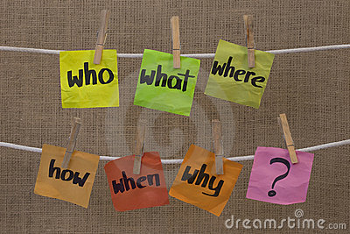
What are you looking for?
Has someone in your family already completed some research
Do you have the time? Have you considered the costs?
Set a Goal!

Slide 6

Genealogy Pox?
Once the genealogy bug bites you, it will become an all-encompassing monster. You will become obsessed! You can’t stop. You will suffer from the disease called the “genealogy pox”!
Ref: Black Roots Tony Burroughs, pg.44

Slide 7

If you are not Organized…
You’ll become frustrated and quit, or duplicate research.

Slide 8

If you do not have a system for filing, saving, or retrieving.
You will become successful in collecting pieces of paper.

Slide 9
What goes OUT must come IN
Whether you're writing to a cousin or to a county clerk three states away, tracking all of your pending information requests is crucial.
Keep copies of all the letters you send — they act as records of what you requested when, and how much.

Slide 10

Get Organized
Get organized-develop your system for filing, saving, or retrieving.
Get a good resource guide/Books-a Go too!
Begin with what you know!
Ask questions about what you don’t know
Figure out who or what might know
Stay in the box! Do not get out of the box
Know you will have challenges
Know that some you might not find

Slide 11
Tips to become and stay organized
Get everything in one place
A designated place; whether that's a binder or a whole file cabinet.
Start by grouping what information you have by surname — it's the most basic piece of information you can have about a family member, and it provides a natural way to organize.
If you've already done a bit of research, you may want to start a separate folder or binder for each surname, but sectioning out what will be in the file (birth, death, marriage, deeds, military, etc.)

Slide 12
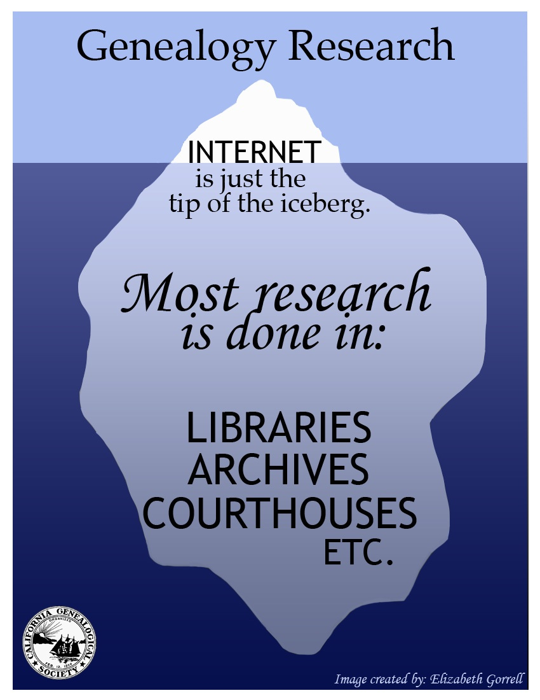
https://www.californiaancestors.org
Permission to use: CALIFORNIA GENALOGICAL SOCIETY BY Elizabeth Gorrell, CGS 2017

Slide 13

TIP!
Get Offline
Get in the Car
Ride a Train
Or take the Plane
GO LOCAL!

Slide 14
More Routine Genealogy!
First steps-set your goal
Determine what records and resources are needed
Gather the records –place information into your timeline
Hopefully, Question, and Analyze the information
Review what you have and determine if there is a “what is next?
Summarize and write it up-Tell the story!

Slide 15
Managing Your Research
Genealogical charts and forms are essential in organizing names, dates, places, and events
Use the standard special charts and forms for genealogical research (see Crooms book or ancestry’s only forms)
Set up a“to do list” and stick with it..

Slide 16
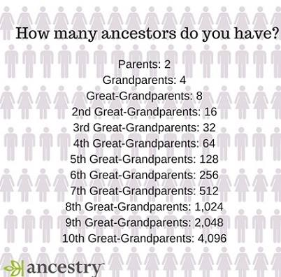

Slide 17
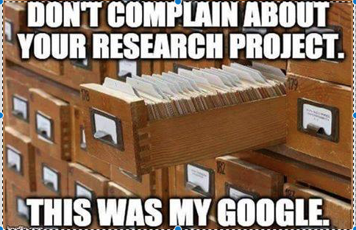
Timelines-a necessary tool that most genealogists do not use.
Reasons why genealogists do not use timelines:
Do not see a benefit of another document for the file
Don’t know How to do them properly
Consider it Too much work and don't want to waste the time
Its Too simple, we know this information
Can you think of anything else?

Slide 18
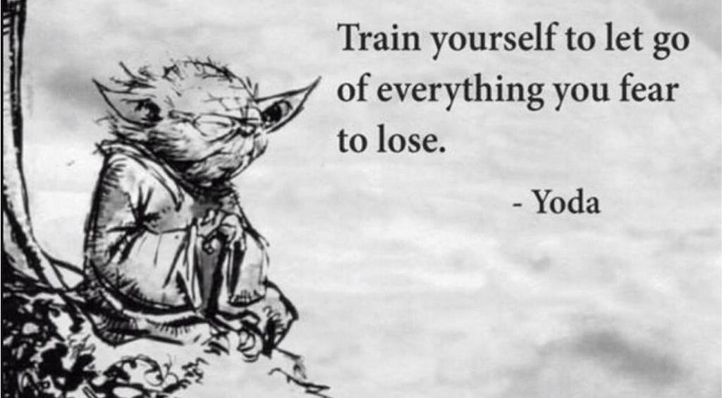
Retrieved from the internet, anon, 2016

Slide 19
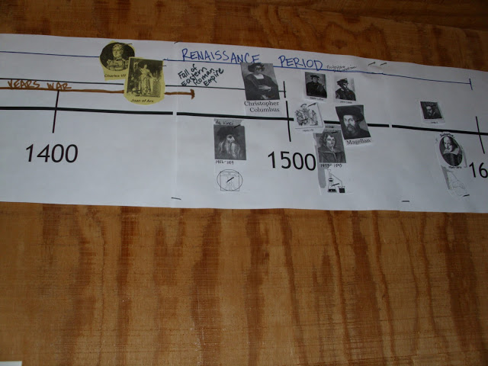
There's a benefit to using a timeline
  It keeps things organized
  Information is in chronological order
  One document with citations and resources and it can be shared (Word/excel, etc.)
  You have the beginnings of a biography of your ancestor
  You are able to see things that could have been an impacts to the ancestor and to the community they lived in

Slide 20
More Benefits
  The conflicts and gaps will be evident giving you the HINT OR LEAD of what you have to resolved
  The next steps ON YOUR TIMELINE are the Beginnings of your research plan
  Timelines can be fancy or simple
  Document is searchable

Slide 21

Droplets of the timeline
What your goal?
Events/resources
Gaps and next Steps
1. Decide on the goal(s)
2. What do you know?
3. decide on what you want to know
4. WHO OR WHAT WILL KNOW?
5. decide what resources and tools you will need
1.what happen at what time?
2. build the census –fed, state, Wars, events, etc.
3. birth, death, will, marriage, divorce, etc.,
4. think about the money, land, water and the faith
5. what is the County/community events that might impacts your ancestor
1. questioned the information
2. analyze the documents or information
3. Conduct a "so what"
4. realize the conflicts or gaps
5. resolve the conflicts or gaps

Slide 22
REMEMBER Records can create records
So when someone passes, besides a Death certificate what other records are created?-give three OR MORE:
1.
2.
3.
Let’s look at …So WHAT!

Slide 23

Know your records and Resources...
as you place information on the timeline use the Murphy’s “SO WHAT” tool
Ask questions, what about others in the family-birth, death, marriage records, wills, and registrations, etc.
Question the document, what law was in place, etc.?
Understand that RECORDS can create RECORDS!
SO WHAT! Copyright Dr. Shelley Viola Murphy 2013

Slide 24
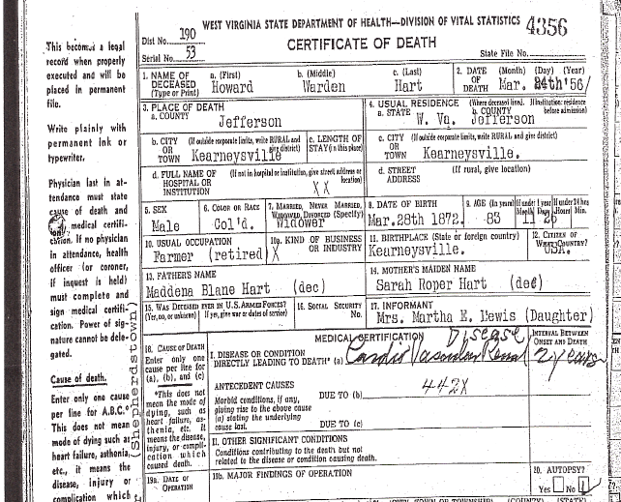

Slide 25
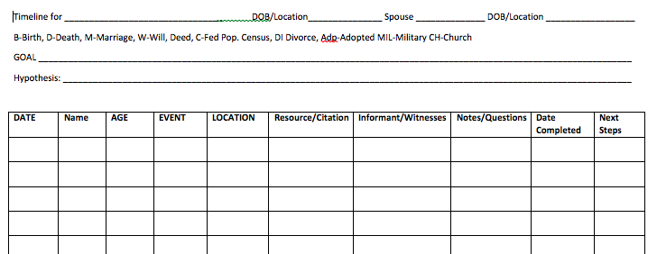
Notes:
Simple, in WORD, can be in what ever you want it to be in, excel, it can be fancy or simple, my recommendation is to just use it.

Slide 26
Building the Timeline-Line by Line, time by time
Things that should be automatically on a Timeline
Birth, Marriages, Death, Wills, Probate, Taxes
State and Federal Census...each year.
Community Events and activities
Wars that had battles or connections to the community your ancestor lived in. Example: 1861-1865...Civil Wars-what happened, any impacts, any crisis that impacted your ancestors
Notable activities and events that occurred

Slide 27
Line by line, cell by cell, time by time
Date- input the dates of what ever the event was and occurred (day-month-year)
Name-input the full name and include nicknames in the notes-as the records appear put the exact spelling of the name as it is on the record
Age -write the age as it is shown, regardless if you do not think it is correct
Citations…where did you get it from? Form...

Slide 28
Events and Resources:
What happen at what time?
Build the census –fed, state, Wars, events, etc.
Birth, death, will, marriage, divorce, etc.,
What is the County/community events that might of impacts your ancestor
Location-list the location, city, town, county, an area, and state, as shown in the record
Notes/Questions-what are you notes, thoughts, on this event? Is there a conflict or a gap, if so, note it and your version or someone else version. ORAL HISTORY+

Slide 29
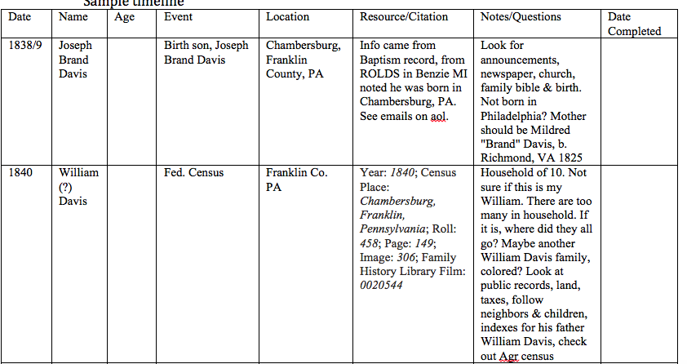

Slide 30
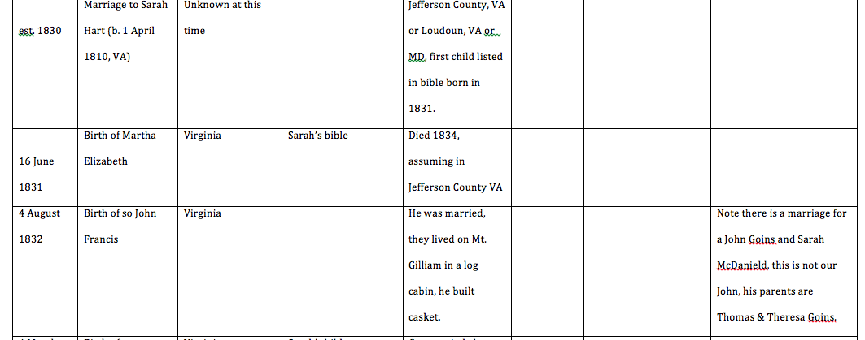

Slide 31
Next steps: Gaps and Next Steps
Questioned the information
Analyze the documents or information
Conduct a "so what"
Realize the conflict or gaps
Resolve the conflicts or gaps

Slide 32
Tell yourself you completed/resolved or DID something
When Completed-note the date you completed something, if you resolved it, or received something, tell when and where you logged the resolution.
This will help you not repeat so much.

Slide 33
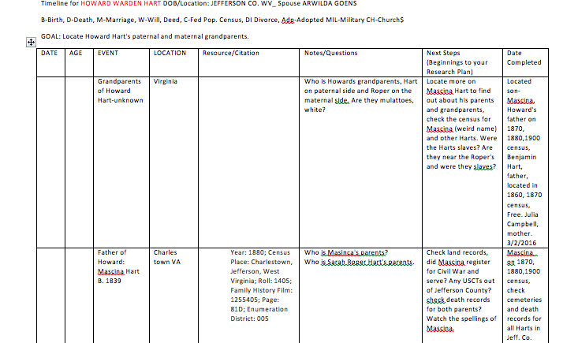

Slide 34

Murphy’s rule Follow the …
Money
Land
Water,
Community, and the
Faith of the People

Slide 35
James Dent Walker’s rule of 3!
If you say Parley Worden’s b. in NY abt. 1795-1800, d. 1852, that his father is arnold worden b. 1763 in CT, d. 1840 in NY-then show 3 things to back it up.
Example: give me records that would show a father son relationship?
1 birth
2 death
3 marriage
What if one or more of these records aren’t available?
What other record/documents could you locate to support a father son relationship, give me one or two-maybe three? ________ ___________ ___________

Slide 36
recap
Timelines are a valuable tool
There is no magic in genealogy-know the basics
Get a good guide(S) to follow
Join local groups, tune in to webinars, attend conferences and institutes
Ask questions to those who have done it
Analyze, analyze, question, question, and more questions

Slide 37
Question for you-
If you do a timeline…Think about it…what will you have while working on it?
What can or will you do with your timeline?

Slide 38
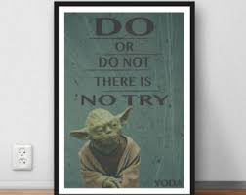

Slide 39

Questions, Comments, questions

Slide 40
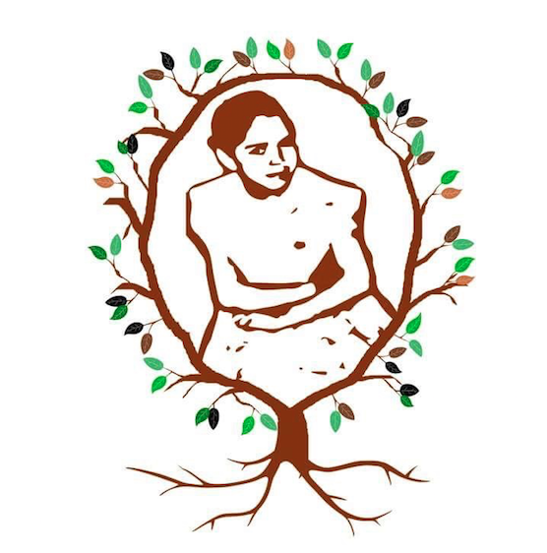
Contact information
Coordinator and Instructor at the Midwest African American Genealogy Institute (MAAGI).
On Facebook and twitter @familytreegirl
Blog: www.familytreegirl.com
Email: familytreegirl@genealogycoach.org
KNOW YOUR ROOTS THEY ARE LONG AND STRONG!

